Slide 1

TA201 PROJECT EVALUATION REPORT MG3 GROUP PPT

Slide 2
Acknowledgement
We would like to express our sincere gratitude to our tutor and lab-in-charge, for their support and instruction in this project. Their support and direction were instrumental throughout the execution of the project.
We thank Dr. Niraj Mohan Chawake, the Course Instructor, and Mr. Indra Pal Singh, the course In-charge, for allowing us to explore our creativity and create something of our own through the lab manufacturing processes.
We also thank our TAs, for their valuable time. We would also like to extend our deepest gratitude to all the lab staff and guides for their encouragement and for training us in the various skills required to complete the project.

Slide 3
Ideation to Reality

Slide 4
TIMELINE
Week 1
Week 2
Week 3
Designing and acquiring materials of required length
Building the frame for the wheel and casting pulley
Welding rods to the sheet and drilling holes on rod
Week 6
Week 5
Week 4
Cleaning and oiling the entire Columbus Machine
Attaching pulley and making the entire assembly functional
Welding and assembling the entire structure

Slide 5
COST ANALYSIS
MATERIAL COST ANALYSIS
S. No. | Component | Length/ Weight/Area | Cost | Price
1. | Mild Steel square Rod (25mm x 25 mm) | 50cm | 450*(0.5/6.096) | Rs 36.909
2. | GI Sheet (3ft x 4ft x 0.35mm) | 800 cm^2 | 820/sheet | Rs 410
3. | Mild Steel Sheet (4ft x 8ft x 1mm) | 150 cm^2 | 945/sheet | Rs 945

Slide 6
4. | Mild Steel square Rod (10mm x 10mm) | 40cm | Rs 63/kg | Rs 15.75
5. | Mild Steel Round Rod (8mm diameter) | 40 cm | Rs 68/kg | Rs 17
6. | Aluminium for melting | 600 gm | Rs 380/kg 0.6*380 | Rs 228
7. | Rivets | 8 pcs | 8*0.25 | Rs 2
8. | Nut and Bolt | 2 pcs | 2*10 | Rs 20

Slide 7
9. | Nut | 1 pc | 1*20 | Rs 20
10. | Grooved Rod | 25cm | 25*4 | Rs 100
11. | Rectangular Mild Steel Plates | 45cm*1.5cm | 945/30 | Rs 31.5
Total Material Cost = Rs 1827

Slide 8
LABOUR COST
S. No. | Type of Labour | Total Hours | Charge | Total Cost
1. | Skilled | 30 | Rs 1065/8 Hr | Rs 3993.75
2. | Unskilled | 144 | Rs 735/8 Hr | Rs 10473.75
Total Labour Cost = Rs 14467.5
TOTAL COST OF PROJECT : Rs 16,294.37

Slide 9
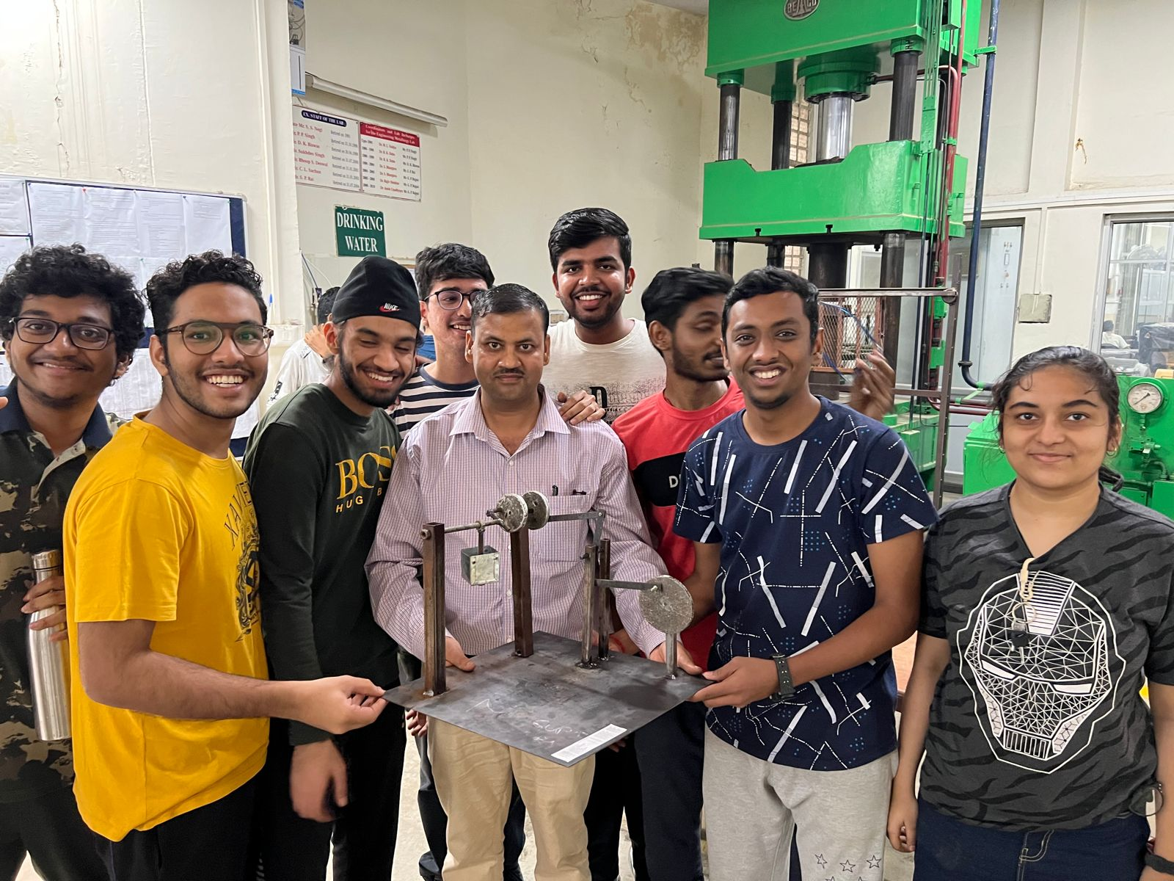
OUR TEAM
Shlok M
Shourya T
Shantanu K
Shreyash N
Shubham A
Saurav K G
Shrilakshmi
Shabadpreet S

Slide 10
Thank you

